Slide 1





Day 4 Joins & Subqueries
Sean Wong
2025/08/04

Slide 2

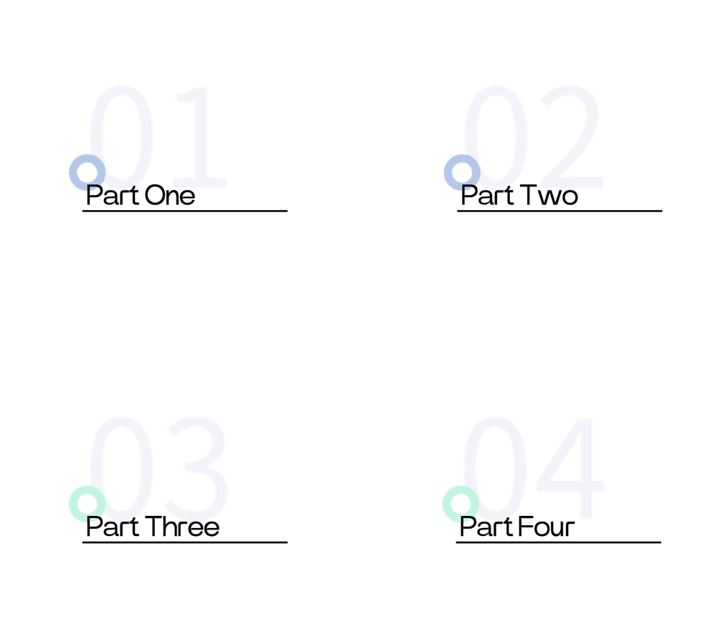
CONTENTS
Kick-off & Recap
Join Fundamentals
Subquery Power
Practice & Wrap-up

Slide 3

Kick-off & Recap

Slide 4




Day 4 Focus
Today, we dive into the powerful world of SQL joins and subqueries. These tools enable you to combine data from multiple tables and perform complex data retrieval tasks, unlocking the full potential of relational databases.
Learning Outcomes
Welcome to Joins & Subqueries
By the end of this session, you will master various join types to merge tables efficiently and use subqueries to solve intricate data problems. These skills are essential for advanced data analysis and reporting.
Practical Application
You will see real-world examples and practice exercises to solidify your understanding. Whether you’re working with employee records or sales data, these techniques will be invaluable.

Slide 5

Course Progress Snapshot
Recap of Days 1-3
So far, we’ve covered MySQL installation, table creation, CRUD operations, and data types. You’ve built a solid foundation in managing and manipulating data within a single table.
Day 4 Objectives
Today, we’ll expand your skill set by exploring how to integrate data from multiple tables using joins and subqueries, preparing you for more complex database interactions.

Slide 6
Join Fundamentals

Slide 7



Definition
Purpose
Joins are essential in relational databases to combine data from two or more tables into a single result set. They bridge the gap between normalized data.
Joins allow you to retrieve related data efficiently, ensuring that you can gather comprehensive information without duplicating data across tables.
Business Impact
Example
Why Relational Data Needs Joins
In real-world applications, joins help in generating meaningful reports, such as combining employee details with department information for HR analytics.
For instance, joining an orders table with a products table can provide detailed insights into customer purchases, enhancing decision-making processes.

Slide 8

Four Join Types You Must Know
Join Types Overview
There are four primary join types: INNER JOIN, LEFT JOIN, RIGHT JOIN, and FULL JOIN. Each serves a unique purpose in combining data from multiple tables, and understanding their differences is crucial for effective data retrieval.

Slide 9





INNER JOIN in Action
Syntax
Example
The INNER JOIN syntax combines rows from two tables where there is a match in specified columns. It ensures that only matching records are included in the result set.
For example, joining an employees table with a departments table using department_id will return only those employees who have a matching department entry, ensuring data consistency.

Slide 10


LEFT JOIN Keeps Every Left Row
LEFT JOIN Definition
Use Case
Visual Aid
A LEFT JOIN returns all rows from the left table and the matched rows from the right table. If no match is found, NULL values are returned for the right table’s columns.
This type of join is useful when you need to include all records from the primary table, such as listing all employees along with their department details, even if some employees do not have a department assigned.
A Venn diagram can help visualize this join, showing all elements of the left table and the intersection with the right table.

Slide 11

RIGHT JOIN Mirrors Logic
RIGHT JOIN Definition
A RIGHT JOIN returns all rows from the right table and the matched rows from the left table. It is the opposite of a LEFT JOIN, ensuring all records from the secondary table are included.
Example
For example, when listing all departments along with employee details, a RIGHT JOIN ensures that even departments without employees are included in the result set.

Slide 12

Simulate FULL JOIN with UNION
Workaround
To achieve a FULL JOIN in MySQL, you can combine LEFT JOIN and RIGHT JOIN results using the UNION operator. This ensures all records from both tables are included.
FULL JOIN Concept
A FULL JOIN retrieves all records when there is a match in either the left or right table. However, MySQL does not natively support FULL JOIN.
Syntax
The syntax involves performing a LEFT JOIN and a RIGHT JOIN separately, then combining the results with UNION to mimic the behavior of a FULL JOIN.
Example
For example, to get all employees and all departments, you can use a combination of LEFT and RIGHT JOIN with UNION to ensure no data is omitted.

Slide 13


LEFT JOIN
When to Choose Each Join
Choose LEFT JOIN when you need all rows from the left table and matching data from the right table. This is useful for master-detail relationships.
INNER JOIN
Use INNER JOIN when you only need matching rows from both tables. This is ideal for reports requiring consistent data across multiple tables.
RIGHT JOIN
RIGHT JOIN is suitable when you need all rows from the right table and matching data from the left table. It’s often used when the secondary table is the primary source of data.

Slide 14
Subquery Power

Slide 15

Definition
A subquery is a query nested inside another query. It allows you to perform complex filtering and data retrieval by breaking down the problem into manageable steps.
Purpose
Subqueries are used to derive values dynamically, filter data based on conditions, and perform calculations that are not possible with a single query.
What Is a Subquery

Slide 16
01
02
Scalar Subqueries
Multi-row Subqueries
Scalar subqueries return a single value and are often used in the SELECT clause or WHERE clause to filter data based on a specific condition.
Multi-row subqueries return multiple values and are used with operators like IN to filter data based on a list of values.
03
04
Correlated Subqueries
Performance Considerations
Correlated subqueries depend on the outer query and are re-executed for each row in the outer query, allowing dynamic filtering based on row-specific conditions.
While subqueries are powerful, they can impact performance. It’s important to use them judiciously and consider alternatives like joins when appropriate.
Scalar Multi-row Correlated Forms

Slide 17



Example
Syntax
Benefits
To find employees earning more than the average salary in their department, you can use a correlated subquery in the WHERE clause to dynamically calculate the average salary.
The syntax involves nesting a subquery that calculates the average salary for each department and comparing it with the employee’s salary in the outer query.
This approach ensures that the threshold for comparison is dynamic and adapts to changes in the underlying data, providing accurate results.
Subqueries Inside WHERE Clause

Slide 18

Subqueries Inside SELECT Clause
Example
Advantages
To display the highest salary in each department, you can use a subquery in the SELECT clause to calculate the maximum salary for each department.
This method keeps the query modular and readable, allowing you to include aggregated insights alongside regular columns without additional joins.

Slide 19

Blend Joins with Subqueries
Hybrid Query Example
Combining joins and subqueries allows you to identify key records using subqueries and then enrich the results with additional data through joins, optimizing both clarity and performance.

Slide 20
Practice & Wrap-up

Slide 21


Hands-on Lab Instructions
Guidance
Lab Goals
Follow the provided checklist to incrementally build your queries. This hands-on practice will reinforce your understanding and prepare you for future database challenges.
The lab exercise aims to apply what you’ve learned about joins and subqueries to real-world data, ensuring you can confidently perform complex data retrieval tasks.
Tasks
Validation
You will perform INNER JOIN, LEFT JOIN, and RIGHT JOIN queries, create subqueries for filtering and aggregation, and combine joins with subqueries to solve advanced problems.
Verify your results using provided solutions or by comparing with peers. This ensures you leave with validated scripts ready for portfolio or workplace application.

Slide 22


Subqueries
Subqueries enable complex data filtering and calculations by breaking down problems into modular steps. They can be used in various clauses to enhance query functionality.
Hybrid Approaches
Joins
Combining joins and subqueries maximizes flexibility and efficiency in data retrieval. This hybrid approach allows you to tackle advanced analytical tasks with confidence.
Joins are essential for combining related data from different tables. Each join type serves a specific purpose, allowing you to tailor your queries to your data retrieval needs.
Key Takeaways Recap

Slide 23

Open Q&A Session
Addressing Concerns
Invitation
The floor is now open for any questions or clarifications on joins, subqueries, or any other topics covered today. Feel free to ask about syntax, use cases, or performance considerations.
We will address common points of confusion and provide deeper insights to ensure you have a solid understanding before moving on to tomorrow’s lesson.

Slide 24

Tomorrow Normalization Awaits
Preview
Tomorrow, we will delve into database normalization and best practices for efficient database design. This will elevate your understanding of how to structure data to minimize redundancy and improve query performance.

Slide 25



Sean Wong
2025/08/04

